Slide 1
Social Media Marketing
Digital marketing Lecture 4

Slide 2
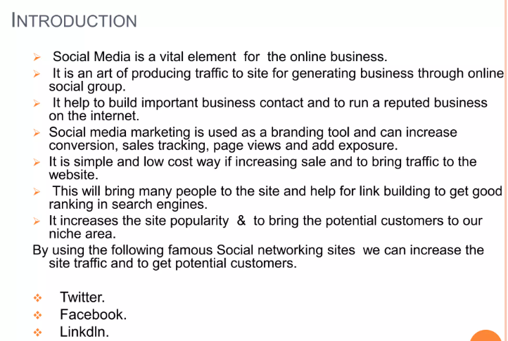

Slide 3
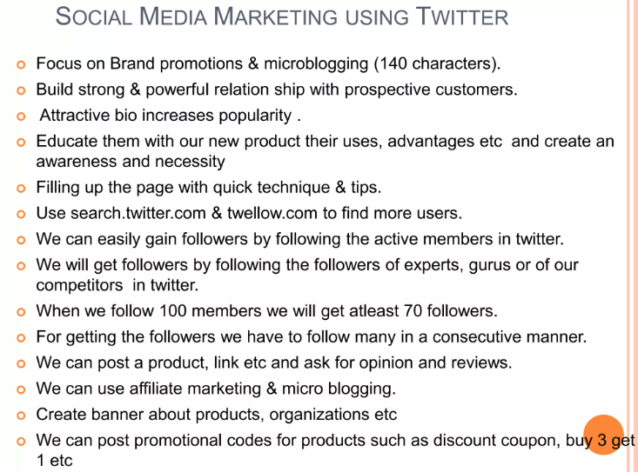

Slide 4
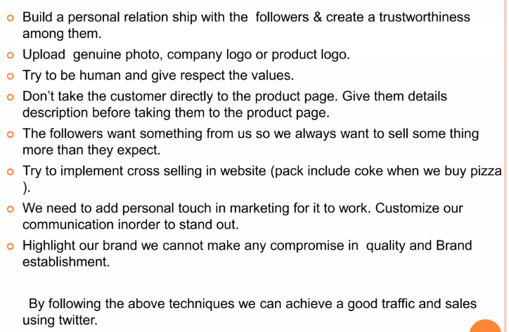

Slide 5
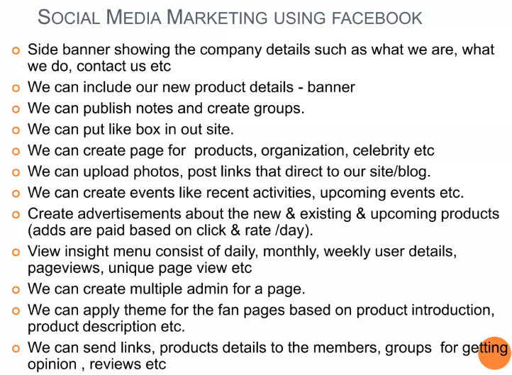

Slide 6
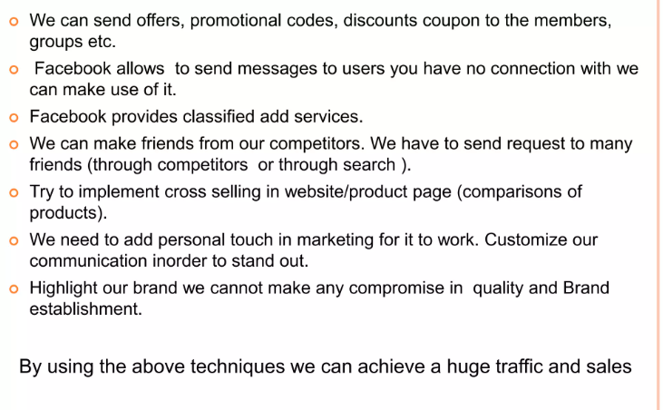

Slide 7
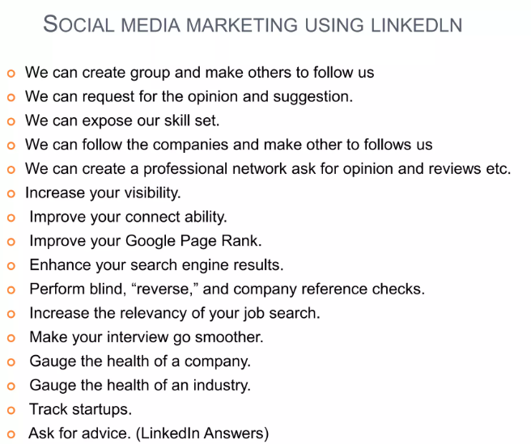

Slide 8
How to build Social Media Strategy

Slide 9
Social Media Strategy
Set goals:
Social media strategy planning starts with your goals. Whether you want to expand your team, build a larger following or a more active community, taking the time to define your social goals is the first step to reaching them.
Either way, your goals will define your social media marketing strategy and how much time and energy you’ll need to dedicate to your campaigns.
The goals may include:
Increase brand awareness
Generate leads and sales
Grow your brand’s audience
Provide holistic customer care
Provide holistic customer care

Slide 10
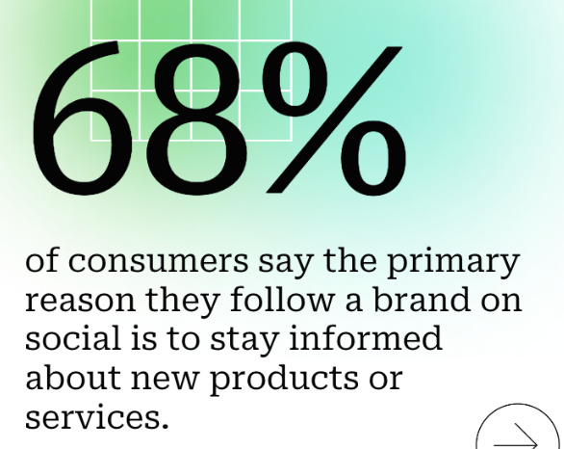
Social Media Strategy
Increase brand awareness
Brand awareness means getting your name out there. Some 68% of consumers say the primary reason they follow a brand on social media is to stay informed about new products or services.

Slide 11
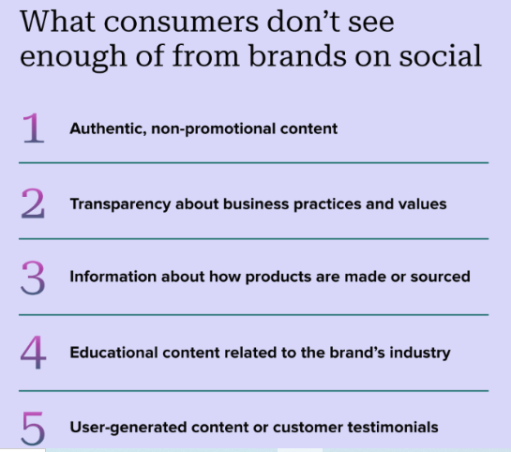

Slide 12

Social Media Strategy
Generate leads and sales
Whether online, in-store or directly through your social profiles, followers don’t make purchases by accident. For example, are you alerting customers about new products and promos? Are you integrating your product catalog into your social profiles? Are you running exclusive deals for followers? Social media gives you an avenue to generate revenue.

Slide 13
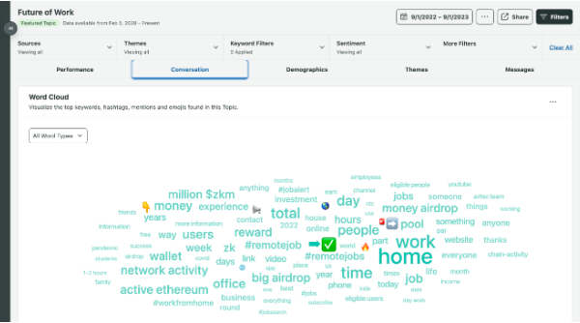
Social Media Strategy
Grow your brand’s audience
Bringing new followers into the fold means finding ways to introduce your brand to folks who haven’t heard of you before. Growing your audience also means discovering conversations around your business and industry that matter the most. Digging through your social channels is nearly impossible without monitoring or listening for specific keywords, phrases or hashtags. Having a pulse on these conversations helps you expand your core audience (and reach adjacent audiences) much faster.

Slide 14
Social Media Strategy
Provide holistic customer care
The Index shows over half of consumers believe the most memorable thing a brand can do on social media is respond to customers.
Although 76% of consumers value quick responses, providing quality customer care isn’t just responding rapidly. Consumer expectations have evolved. Some 70% of consumers expect brands to provide a holistic experience with personalized responses that fit their unique customer service needs.
This means companies need to experiment with messaging and content when approaching customer care. For example,
Does your team have a protocol for handling @-mentions and comments?
Do you have templated responses to FAQs?
Does your brand promote user-generated content and hashtags?
Your customers can be your best cheerleaders, but only if you give them a reason to grab the megaphone.

Slide 15
Social Media Strategy
Drive traffic to your site to illustrate ROI of social efforts
About 46% of marketers plan to calculate the return on investment (ROI) of advertising spend to connect the value of social to business goals.
Simple enough. If you’re laser-focused on generating leads or traffic to your website, social media can make it happen. Whether through organic promotional posts or social ads, keeping an eye on conversions and URL clicks can help you better determine your ROI from social media.
Any combination of these goals is fair game and can help you better understand which networks to tackle, too. When in doubt, keep your social media marketing strategy simple rather than complicating it with too many objectives that might distract you. Pick one or two and rally your team around them.

Slide 16
Social Media Strategy
Research your target audience and select your networks
Making assumptions is bad news for marketers. Both leaders and practitioners can disprove assumptions from the valuable insights social data provides. With the right tool, marketers can quickly research their audience. No formal market research or data science chops necessary.
What you need to know about your audience to influence your social media marketing strategy is already available. You just have to know where to look.

Slide 17
Establish your most important metrics and KPIs
No matter your goals or industry, your social media strategy should be data-driven. Rather than focus on vanity metrics, dig into data that aligns directly with your goals.
So, what metrics are we talking about? Below you’ll find a quick overview, but our full guide breaks down the social media metrics that matter (and why) in more detail.
Reach. Post reach is the number of unique users who saw your post. How much of your content actually reaches users’ feeds?
Clicks. This is the number of clicks on your content or account. Tracking clicks per campaign is essential to understand what drives curiosity or encourages people to buy.

Slide 18
Establish your most important metrics and KPIs
Engagement. The total number of social interactions divided by the number of impressions. This sheds light on how well your audience perceives you and their willingness to interact.
Hashtag performance. What were your most-used hashtags? Which hashtags were most associated with your brand? Having these answers can help shape the focus of your content going forward.
Organic and paid likes. Beyond a standard Like count, these interactions are attributed to paid or organic content. Given how much harder organic engagement is to gain, many brands turn to ads. Knowing these differences can help you budget both your ad spend and the time you invest in different formats.
Sentiment. This is the measurement of how users react to your content, brand or hashtag. Did customers find your recent campaign offensive? What type of sentiment do people associate with your campaign hashtag? It’s always better to dig deeper and find out how people talk or feel about your brand.

Slide 19
Establish your most important metrics and KPIs
Hashtag performance. What were your most-used hashtags? Which hashtags were most associated with your brand? Having these answers can help shape the focus of your content going forward.
Organic and paid likes. Beyond a standard Like count, these interactions are attributed to paid or organic content. Given how much harder organic engagement is to gain, many brands turn to ads. Knowing these differences can help you budget both your ad spend and the time you invest in different formats.
Sentiment. This is the measurement of how users react to your content, brand or hashtag. Did customers find your recent campaign offensive? What type of sentiment do people associate with your campaign hashtag? It’s always better to dig deeper and find out how people talk or feel about your brand.
Reply time. This refers to how long it takes for your team to reply to a customer message or @-mention on social.
Total response volume. The sum of responses your team sends to customers.

Slide 20
Establish your most important metrics and KPIs
Customer satisfaction score (CSAT). A CSAT shows how satisfied customers are with your product, service or brand as a whole. You can use social messaging to measure CSAT by DMing customers and asking them how likely they are to refer your business. Or by working with your customer care team to formalize a survey for after interactions.
Impressions. The number of times a piece of content was displayed to users. Impressions can indicate how well you’re promoting your account, content, campaigns, ads, etc.
Brand mentions. This number tracks how many times a brand is mentioned in posts/comments, whether the brand is directly tagged or not.
Share of voice (SOV). This indicates where your brand ranks in the market compared to competitors. SOV can help you understand how much of the industry conversation your brand dominates.
Conversation rate. This metric measures how many people you convert to take a desired action on social, such as making a purchase, downloading gated content, or signing up for a free trial, webinar, newletter, etc.

Slide 21
Create (and curate) engaging social content
No surprises here. Your social media marketing strategy hinges on your content. At this point, you should have a pretty good idea of what to publish based on your goals, audience and brand identity. You probably feel confident in which networks to cover, too.
But what about your content strategy? Below are some tips, ideas and inspiration that can help.

Slide 22
Defining your content strategy
Coming up with a content strategy might seem like a lot of legwork, but it all really boils down to your goals.
Looking to educate your audience in the B2B space? Publish blogs, news and opinions relevant to your industry.
Trying to push e-commerce products? Post action shots of your products and photos of others showing off your swag.
Focused on customer service? Tips, shout-outs and company updates are fair game.

Slide 23

Hashtags
Regardless of what you might post, coming up with a hashtag to couple with your content is a brilliant branding move.
Hashtags can be used to get your attention and encourage people to share their photos interacting with your brand.

Slide 24

Hashtags can be used to get your attention and encourage people to share their photos interacting with your brand.

Slide 25
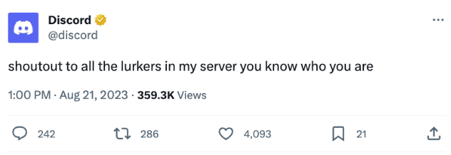
Find your brand voice
One of the best ways to stand out on social media is to define your distinct brand voice. Chances are you’ve seen a post from a particular brand that just feels like, well, theirs.
Of course, not every company will benefit from the same sort of tone. The key is to present yourself as a human rather than a robot. Adopt a consistent brand voice and style that’s appropriate for your business.

Slide 26
Make your social presence as timely as possible
Timeliness is arguably more important than ever for marketers. Not only are you expected to put out fresh content regularly, but also to always be “on” for your followers. But you can’t always expect customers to operate on your clock. And timeliness is a tall order when you’re strapped for resources or are part of a small team.

Slide 27
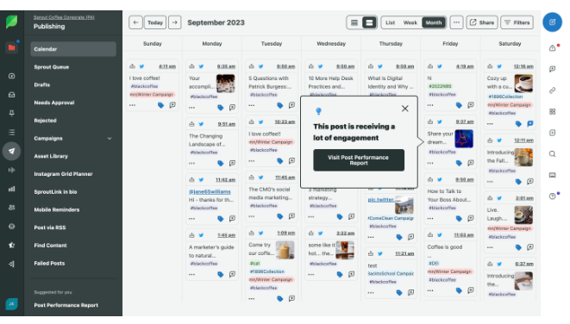
Assemble your content calendar
Use a content calendar to plan out your posts and stay organized. Knowing in advance what you’re going to post will save you a lot of time and keeps you from posting the same pieces of content too frequently.

Slide 28
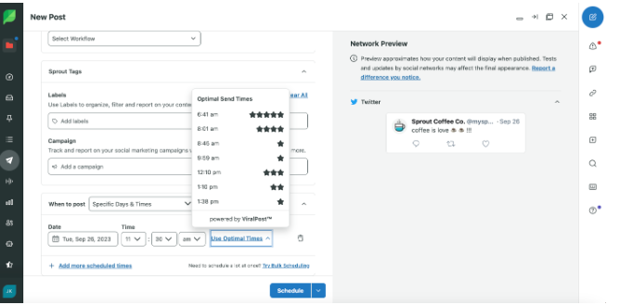
Post at the best times to engage
As evidenced by our best times to post on social, brands have a lot of ground to cover in terms of frequency and how much content to push. It’s important to pay attention to the optimal times for engagement so you can automate the most tedious aspects of your social presence without having to worry about posting in real time.

Slide 29
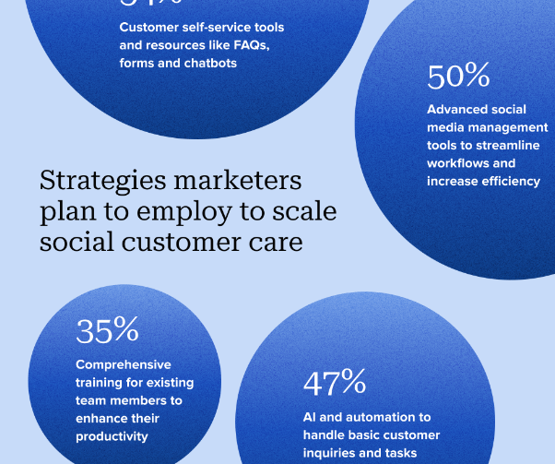
Respond to your customer questions and shout-outs ASAP
Your customers want speedy responses, but it’s likely impossible to respond to every message across multiple channels manually. Lean into AI to help execute faster. For example, you can use chatbots or automated replies to connect with customers when your team is offline.
The 2023 Index shows 81% of marketers say AI has already had a positive impact on their work. But marketers aren’t just using AI to increase efficiency–they’re using it to scale their entire customer care strategies.
Over half of marketers plan to use customer self-service resources like FAQs, forums and chatbots to grow their social customer care strategy. Nearly half of brands say they will use AI and automation to handle basic customer inquiries and tasks.

Slide 30
Evaluate and improve your social media strategy
Without continuously analyzing your efforts, you’ll never know how one campaign did over another. Having a bird’s eye view of your social media activity helps put things into perspective. This means looking at your top-performing content and adjusting your campaigns when your content stalls.
There’s no denying that a lot of social media is a matter of trial-and-error. Monitoring the metrics behind your campaigns in real time allows you to make small tweaks to your social media marketing strategy rather than sweeping, time-consuming changes.
Doing social media marketing right starts by being diligent about your data. You can be reactive in the short term to get the most out of your running campaigns, and then proactively use these takeaways to inform your next strategy overhaul.

Slide 31
Evaluate and improve your social media strategy
To guarantee that you get in front of as many customers as possible, monitoring your growth is a major must-do. With Sprout, social reports can clue you in on everything from your top-performing content to how engaged your audience is. These reports are crucial for accountability and guaranteeing your numbers continue to tick upward.
Based on your data, you can better assess whether your KPIs truly ladder up to your overarching company goals or whether they need to change.

Slide 32
Bring other departments into the mix
Social media teams have a unique advantage when it comes to understanding customer sentiment. You’re the eyes and ears for your brand online. Those insights can do more than just inform marketing strategy. They can transform your business. Stand-out social media teams will approach cross-department collaboration with enthusiasm and intention.
Human Resources
Sales
Product and merchandising
Customer care

Slide 33
Paid Media Advertising

